Slide 1
Term Deposit Data Analysis

Slide 2
Table of contents
01.
02.
03.
Business Challenge
Analysis Scope
Analysis and Insights
04.
05.
06.
Recommendations
Modeling
Data Warehouse

Slide 3
Business Challenge
01

Slide 4
Term Deposit
In banking systems, term deposit is one of the main pillars functions and services that banking systems provide to customers and is the main source of funds for investments and loans.
Notes:
Term deposit is one of the main pillars functions and services that banking systems provide to customers and is the main source of funds for investments and loans, so this analysis will provide some insights and patterns that will show the important parameters of customers to target them in next campaigns.

Slide 5
Table of contents
01.
02.
03.
Business Challenge
Analysis Scope
Analysis and Insights
04.
05.
06.
Recommendations
Modeling
Data Warehouse

Slide 6
Analysis Scope
02

Slide 7



Analysis Scope
Analysis Base
Scope of Analysis
Inclusion & Exclusion
Time Frame
Term Deposit dataset from Kaggle.
Term deposit subscription and feature affects it.
Features associated to term deposit subscription.
Current campaign and previous campaigns.

Slide 8
Data Included
31,648
18
Observations
Features

Slide 9
Table of contents
01.
02.
03.
Business Challenge
Analysis Scope
Analysis and Insights
04.
05.
06.
Recommendations
Modeling
Data Warehouse

Slide 10
Analysis and Insights
03

Slide 11
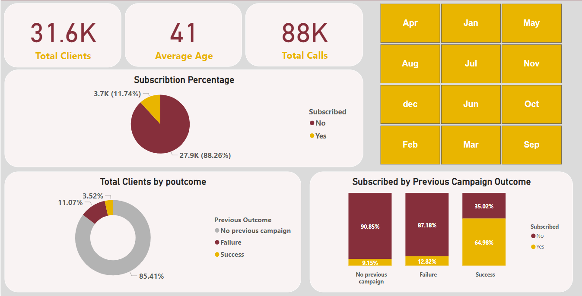
General Analysis

Slide 12
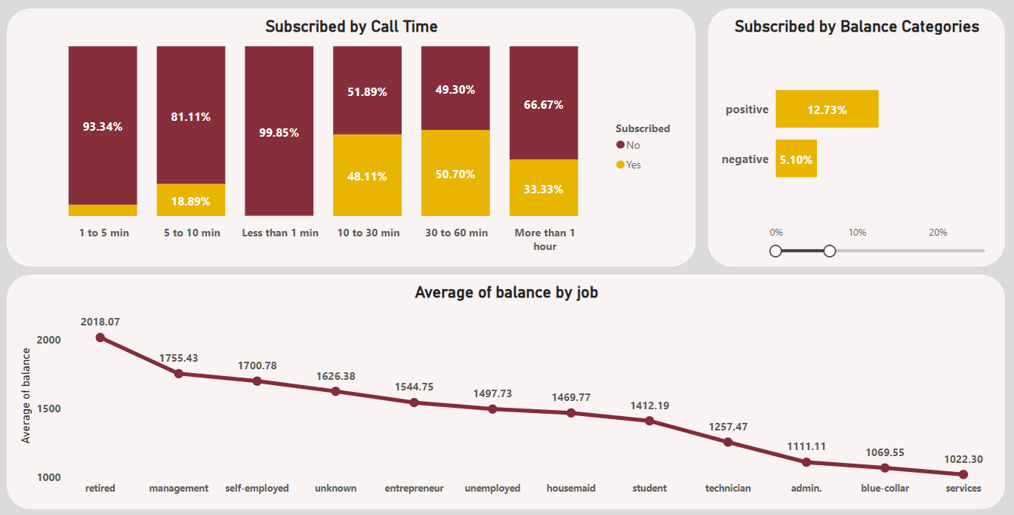
Business Requirements

Slide 13
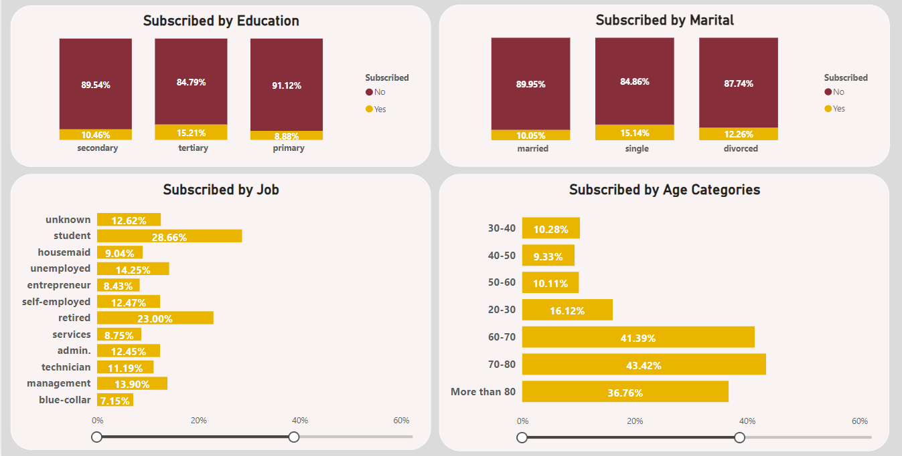
Demographics

Slide 14
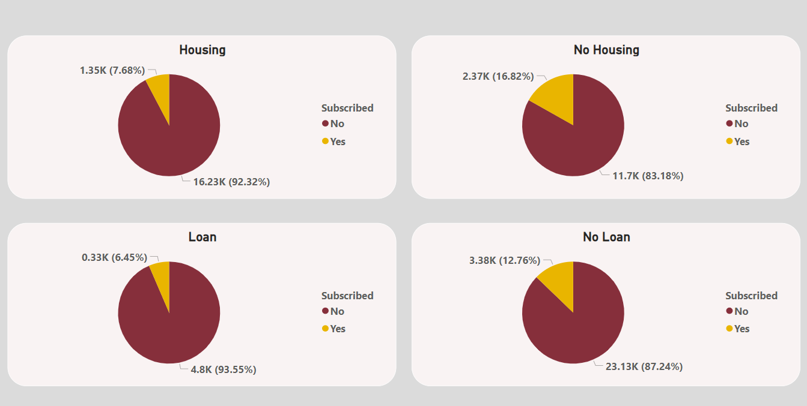
Loans

Slide 15
Table of contents
01.
02.
03.
Business Challenge
Analysis Scope
Analysis and Insights
04.
05.
06.
Recommendations
Modeling
Data Warehouse

Slide 16
Recommendations
04

Slide 17
Recommendations
01
02
03
04
No Loan or Negative Balance
Previous Campaigns
Long Call
Time
Retirees and Olds
Focus more on subscribed customers of previous campaigns.
Target customers who have more call time compared to others.
Retirees and olds are always the most willing to make a deposit, so target them.
Save your effort and reduce targeting people have loans or with negative balances.

Slide 18
Table of contents
01.
02.
03.
Business Challenge
Analysis Scope
Analysis and Insights
04.
05.
06.
Recommendations
Modeling
Data Warehouse

Slide 19
Modeling
05

Slide 21
Introduction

Slide 22
Introduction

Slide 23
Introduction

Slide 24
DE

Slide 25
DE

Slide 26
DE

Slide 27
DE

Slide 28

Modeling

Slide 29
Modeling

Slide 30
THE END

Slide 31
Table of contents
01.
02.
03.
Business Challenge
Analysis Scope
Analysis and Insights
04.
05.
06.
Recommendations
Modeling
Data Warehouse

Slide 32
Data Warehouse
06

Slide 33
Road to DW Model
01
02
03
04
Understanding the Buseniess Statement
Answering Business Questions
Logical Model
Physical Model
3 Main Prespictive
Marketing - Finane –Customer Care .
Why Star Schema?
Defining each Dimension.
Retirees and olds are always the most willing to make a deposit, so target them.
Focuse on Customer Demographics .

Slide 34
Business Statement
Marketing Team
Finance Team
Customer Care
Demographic :
Age – Education – Job – City , etc.
Focused in Profit , Cost , Expenses.
Manage the Process of customers Feedbacks and what actions are performed .

Slide 35
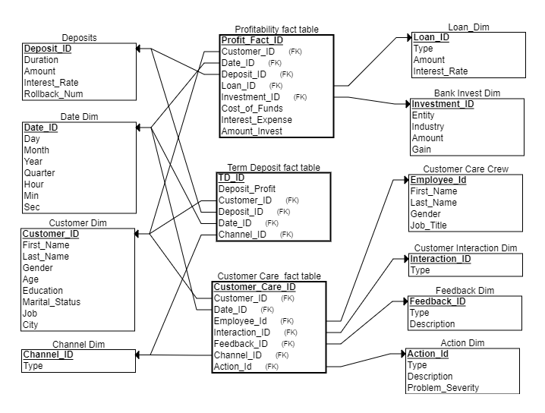
Logical Model

Slide 36
THANK YOU

